Slide 1
WELCOME

Slide 2
“
WASTE FOOD MANAGEMENT & DONATION
”

Slide 3

TEAM 04
MD. ASHFAQ AYUB 22-46369-1
FARIA AHMED RICHI 22-46371-1
ABDULLAH JARIF 22-46386-1
ESHITA RANI ACHARJEE 22-46397-1

Slide 4
TABLE OF CONTENTS
What is use case diagram
Components of Use Case Diagram
Use case diagram
Purpose of Use Case Diagram

Slide 5
Use Case Diagram describe high level function and scope of a system. These diagrams also identify the interactions between the system and its actors. Use case concept used in software development, product design, and other fields to describe how a system can be used to achieve specific goals or tasks.

Slide 6
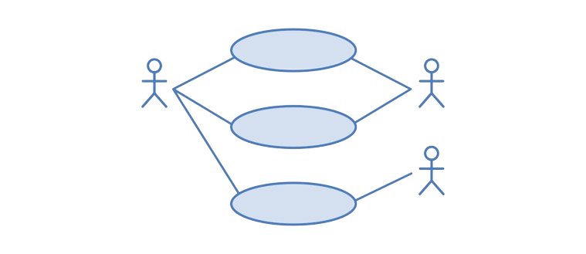
Components of Use Case Diagram
Actors
Use cases
Relationships
Systems

Slide 7
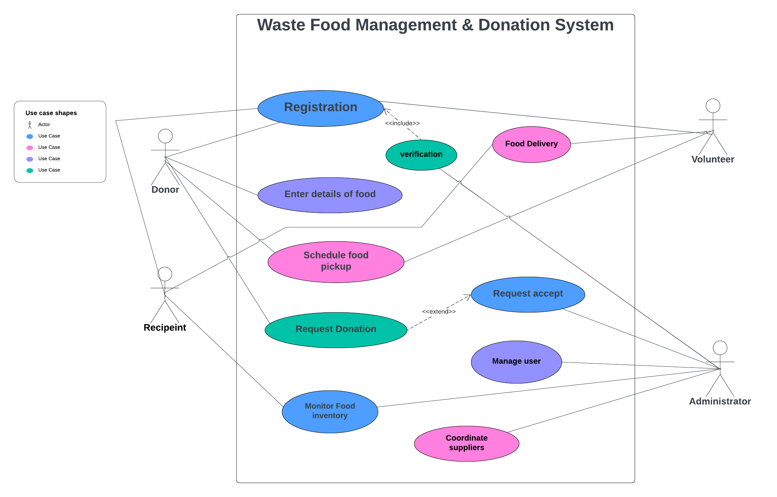

Slide 8
Purpose of Use Case Diagram
Communication and collaboration
Understanding System Requirements
Use Case Diagram
Identifying Use cases
System design and architecture

Slide 9


Slide 10
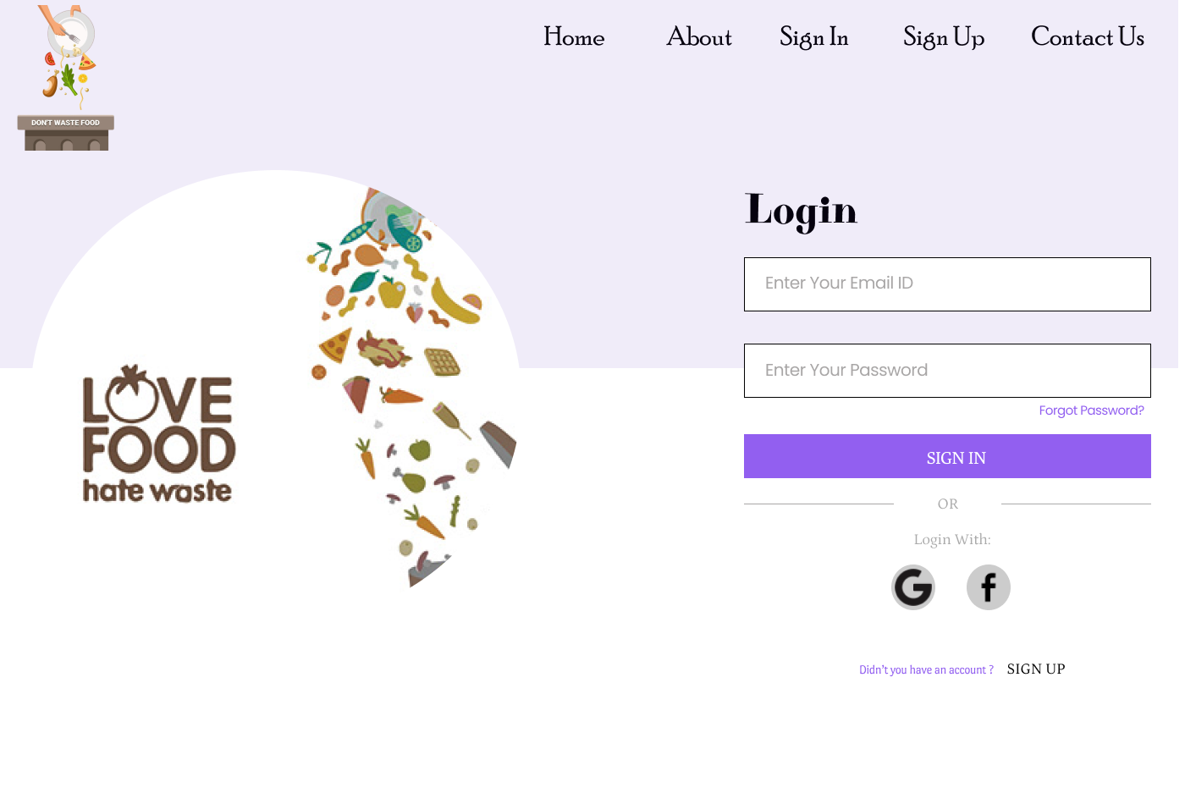

Slide 11
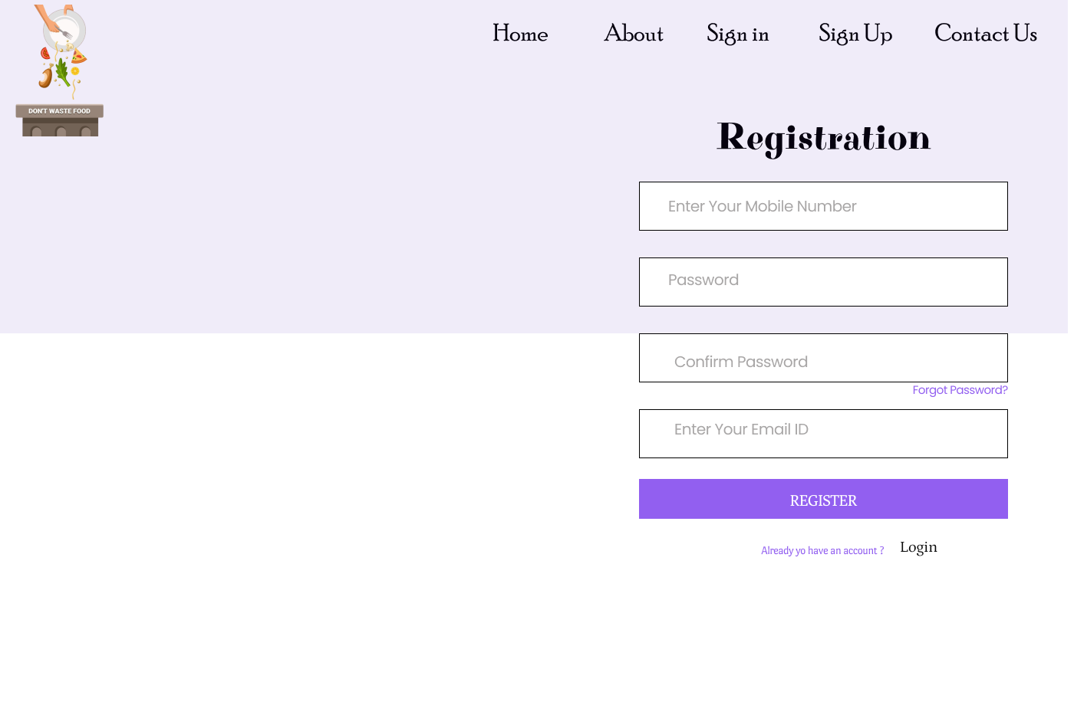

Slide 12
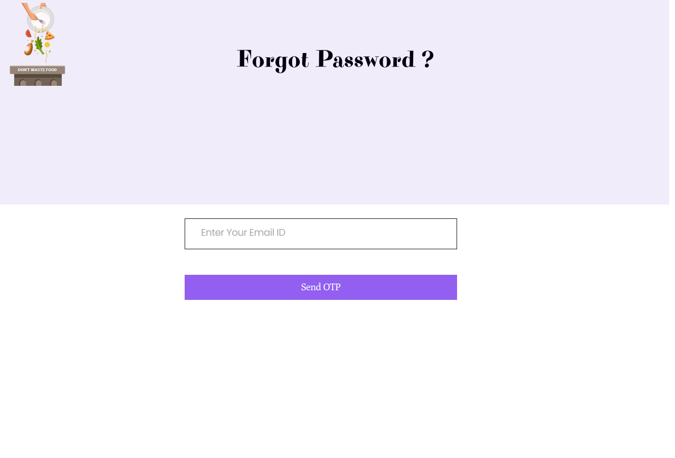

Slide 13
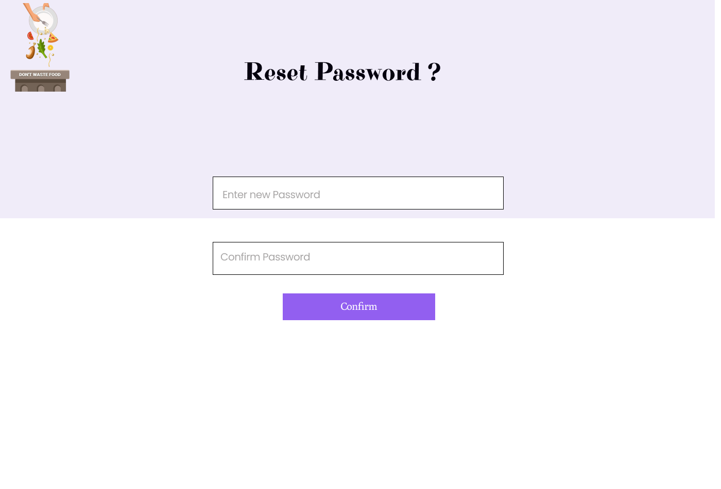

Slide 14
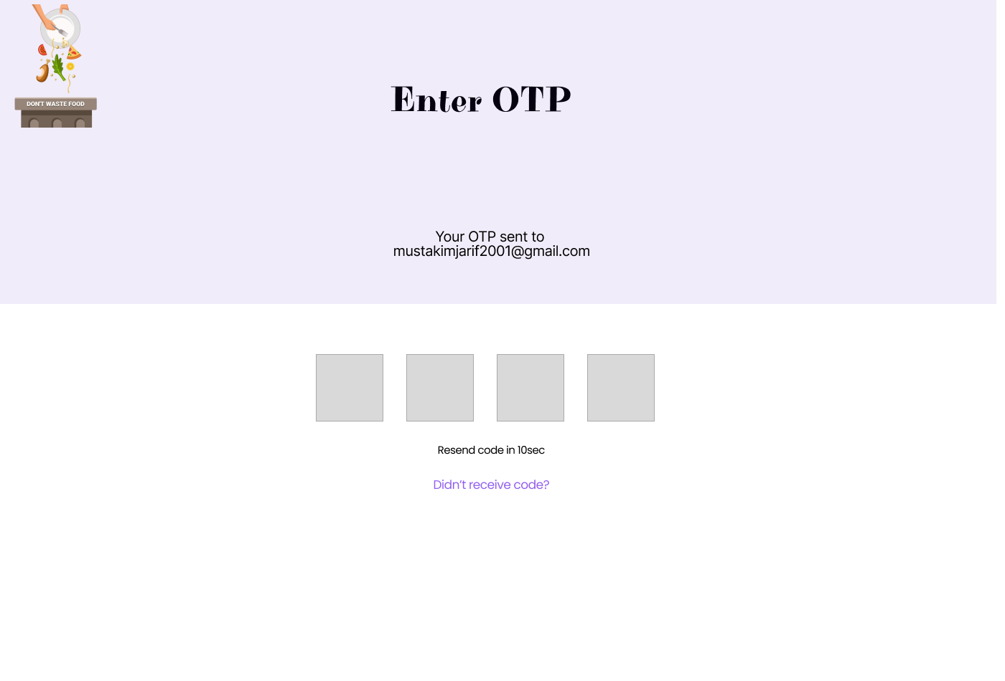

Slide 15
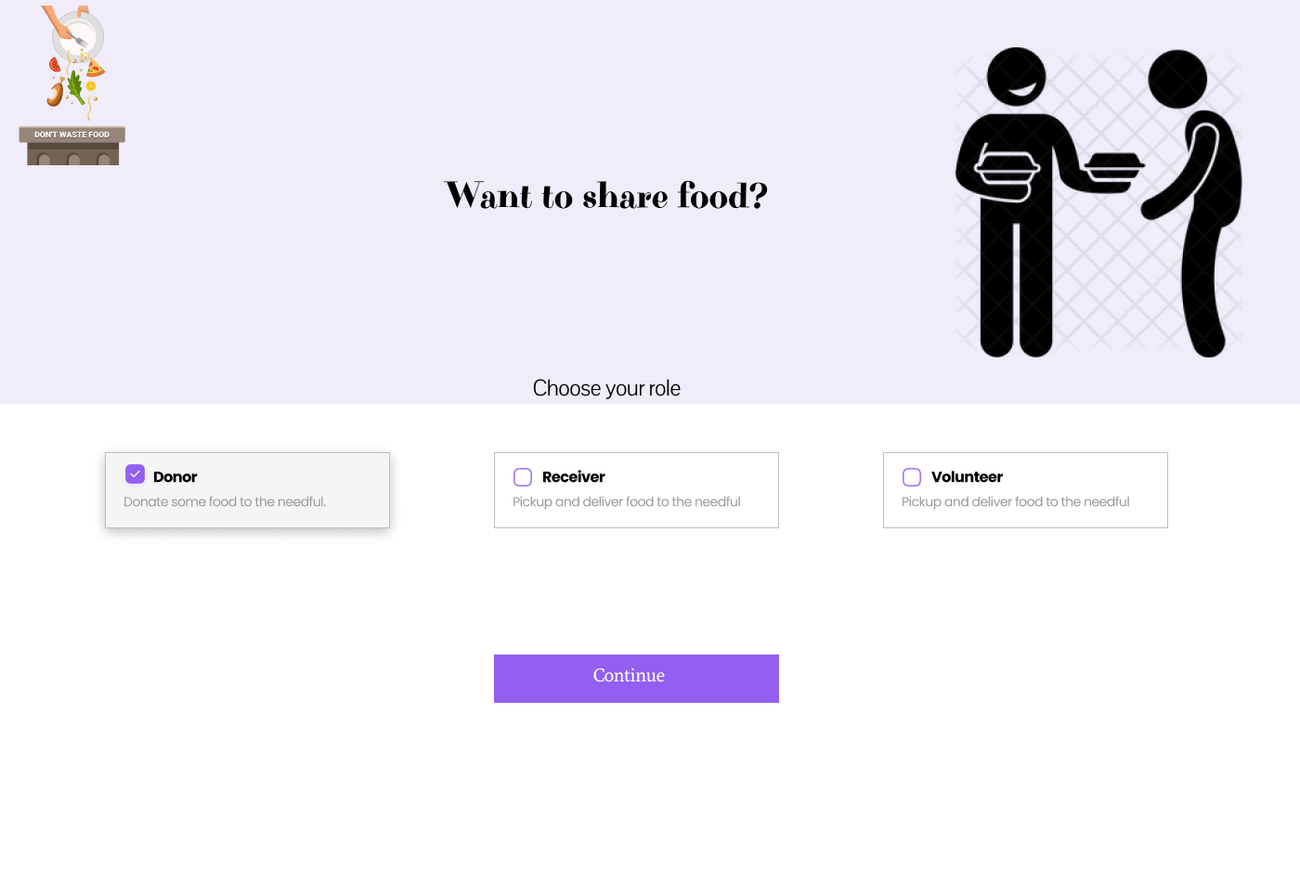

Slide 16
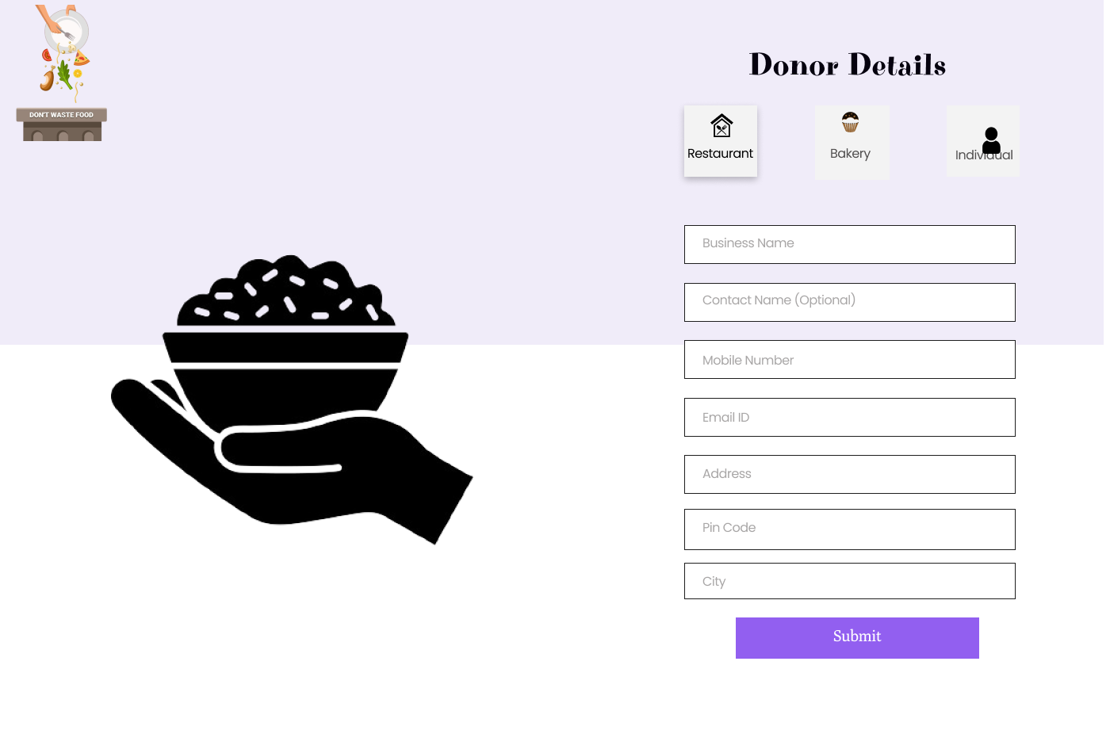

Slide 17
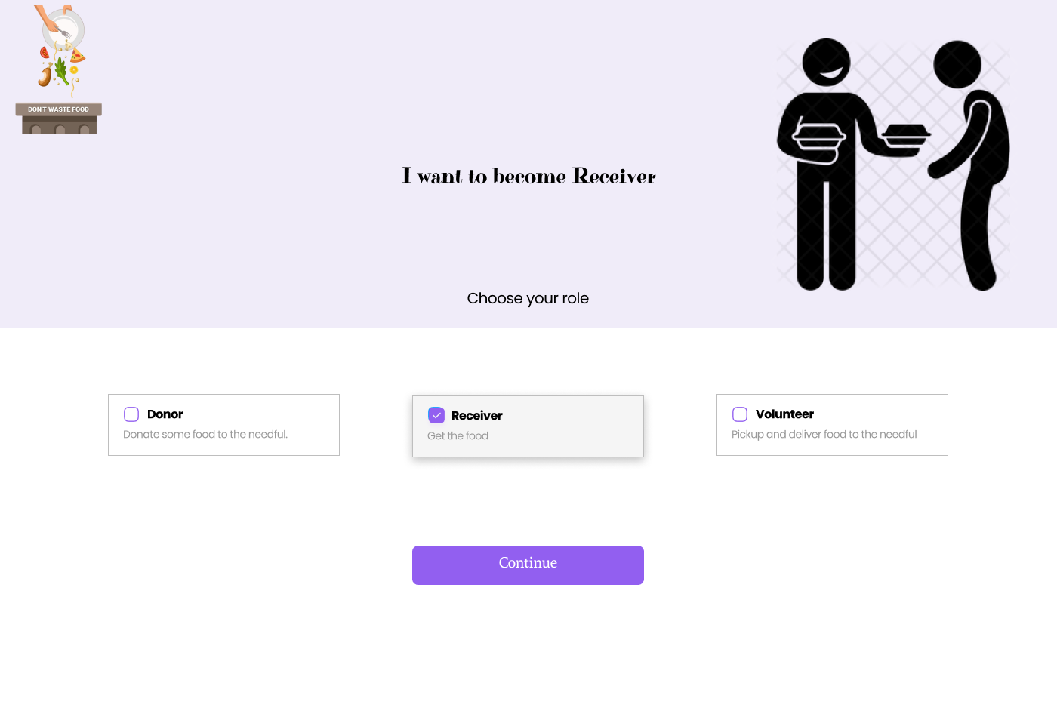

Slide 18
